Slide 1


Summer Reading

Slide 2
Surf to success!
READ A BOOK!
LOG IT!
REPEAT!
Read at least 5 books this summer & you’ll be entered into our raffle.
When you’re done reading, fill out the digital or paper log.
Pick something to read that interests you. It’s your choice!

Slide 3
It’s All about choice!
You may choose to read anything that you’d like this summer. Be sure that your selected books:
  Challenge you
  Are of interest to you
You may read:
  Fiction
  Non-fiction
  Biographies
  Poetry
  Graphic Novels
  Magazines
Need some ideas to get started? Check out our recommended reading list

Slide 4
Where can i find books to read?

Slide 5
Access to physical books
Read books that you have at your house
Reread a favorite book
Borrow a book from the Jackson Branch of the Ocean County Library
Borrow books from a friend or sibling
Read a magazine or comic book

Slide 6
Digital access to books
Destiny Library Catalog: eBooks
Ocean County Library
Epic - Login with your Google ID and use class code zly9960
Tumble Books
Loyal Books

Slide 7
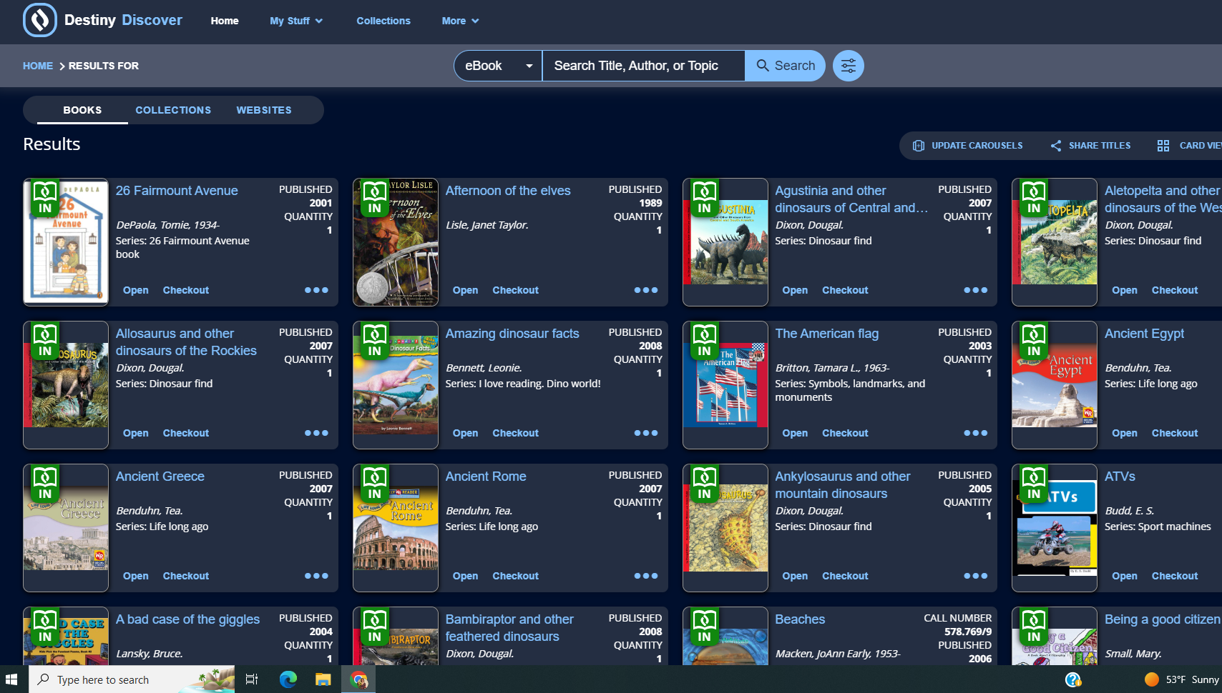
Destiny library catalog
Check out our eBook collection on Destiny.
  We have over 650 books. Use your school ID number as the login AND password
  Or, Username: Elms Password: guest
  eBook Directions

Slide 8
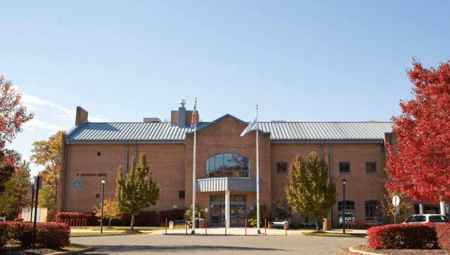

Ocean County Library
Need something new to read? Your Ocean County Library card enables you to check out physical books & materials when the library is open, or ebooks when it’s closed. Don’t have a library card? Click here for a temporary, digital library card.
Check out their Summer Reading Video here!

Slide 9

TumbleBooks
You have free access to TumbleBooks as long as you have an Ocean County Library Card.
  Tumblebooks

Slide 10
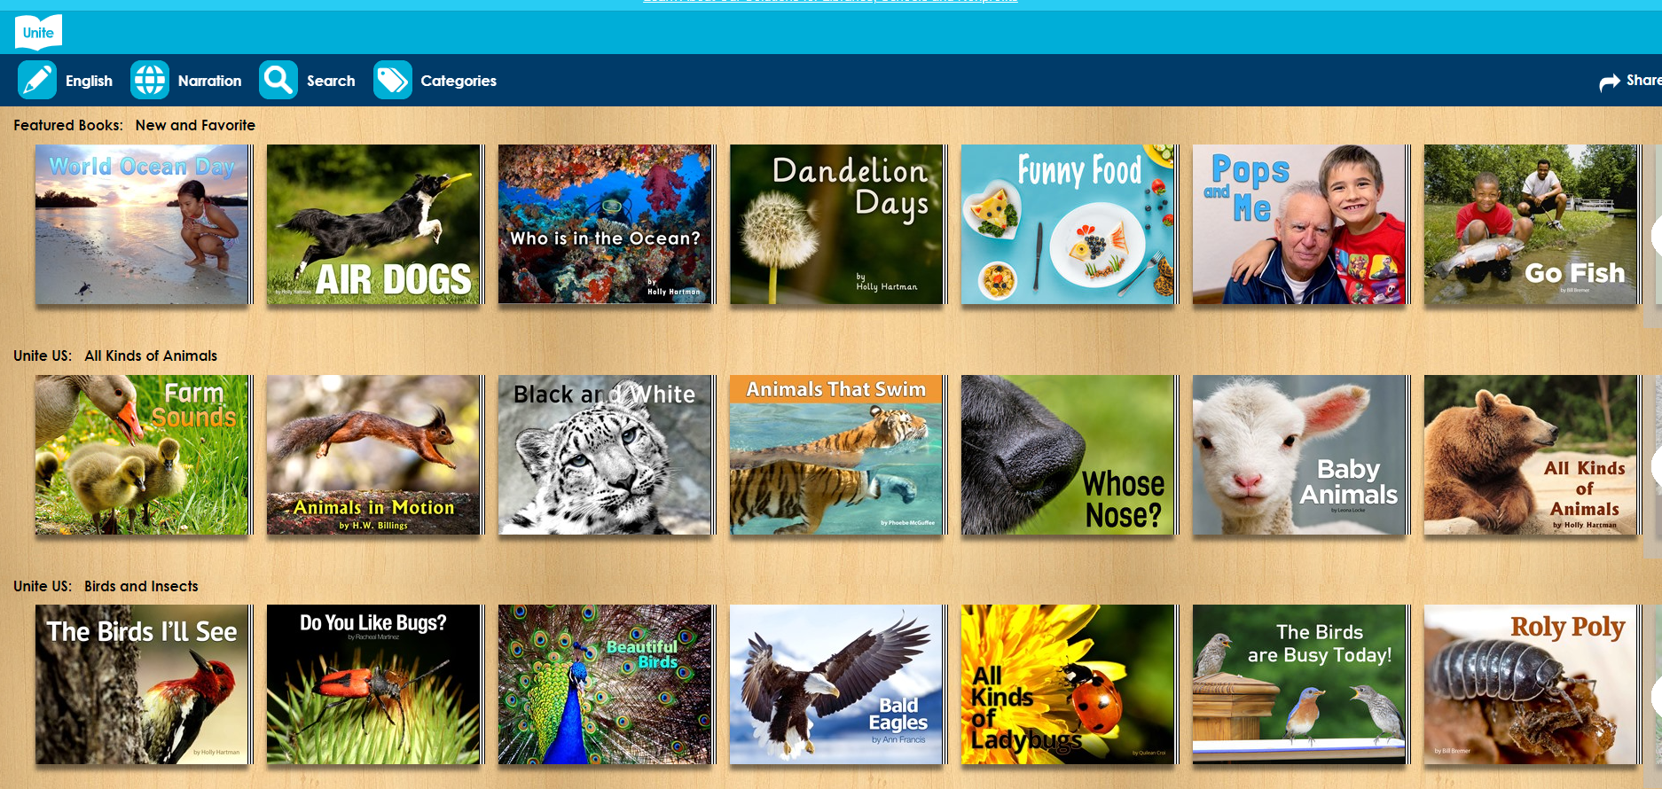
Unite for Literacy or EPIC
Unite For Literacy provides free access to eBooks in multiple languages. Epic has books, videos, and Read To Me texts. There’s something for everyone on these FREE sites!
Unite For Literacy
Epic - Login with your Google ID and use class code zly9960

Slide 11

Important information
Kids who read 5 books will play a special kickball game with Mr. B, Mr. D, Mrs. F, or Mr. M in the fall!
Kids who read 5 books be entered into the prize raffles.
PARENT LETTER
READING LOG
RECOMMENDED READING LIST
CLICK HERE TO FIND A LIST OF TITLES TO CONSIDER
CHOOSE YOUR TRACKING METHOD:
DIGITAL LOG
PRINT LOG
CLICK HERE TO VIEW SUMMER READING DIRECTIONS
Kids who read 5 books will receive ice pops from the PTN in September!

Slide 12
Happy reading!

